Slide 1

ATLIQ MART Sales Performance Dashboard

Slide 2
BUSINESS CONTEXT & OBJECTIVE
A retail company runs promotional
campaigns like Diwali and Sankranti to
boost product sales, and this dataset
tracks product sales before and after
promotions across multiple stores and
cities.
Objective
Context
Analyze the impact of promotional campaigns on product sales
Identify the most effective promotion types
Evaluate campaign performance across cities and stores
Determine top-selling products and categories during promotions

Slide 3
INDUSTRY OUTLOOK
Problem Statement
The company runs promotional campaigns to increase product sales.
Different discount strategies are used across products and stores.
The company does not know which promotion performs best.
Sales performance varies across cities and product categories.

Slide 4
Stakeholders
Makes decisions about future campaigns and pricing strategy
Responsible for product in stores
Uses insights to improve store performance
Strategy Team
Sales Team
Plans promotional campaigns like Diwali and Sankranti
Uses analysis to understand which promotion works best
Marketing Team
Interested in overall revenue growth and profitability
Use insights for high-level business decisions
Manage individual stores in different cities
Want to know which products sell more during promotions
Top Management
Retail Store Managers

Slide 5
Technology Stack
Primary analysis tool. Used for data cleaning, XLOOKUP/SUMIFS enrichment, Sales Growth % column, Pivot Tables .
Data Cleaning
📗 Microsoft Excel
XLOOKUP / SUMIFS
Formula Columns
Pivot Tables
Pivot Charts
Used for querying relational databases, writing JOIN operations to combine tables, filtering large datasets, and aggregating sales data with GROUP BY.
SELECT / WHERE
🗄 SQL
Table JOINs
GROUP BY Aggregations
Subqueries
Window Functions
Used to build interactive dashboards with slicers, bar/line/pie charts, and drill-through pages for executive reporting.
Data Modelling
📊 Power BI (Desktop)
DAX Measures
Dashboard Design
Drill-through
Slicers / Filters
☁ Power BI Service

Slide 6
Data
Data Architecture Data Overview | Data Dictionary | Metadata | ER Diagram |

Slide 7
Data Overview
Dataset Summary
Total Records: ~1500+ rows
Total Columns: 17 fields
Data Type: Retail Sales & Promotional Campaign Data
Campaigns: Diwali, Sankranti
Key Variables: Store ID, Product Code, Campaign ID, Promotion Type, Sales Before & After Promotion, City
50+
1,500
2
15
Store
Events
Campaigns
Product

Slide 8
Available Data & Data Dictionary
05 | Available Data & Data Dictionary
fact_events
1,500 rows · 17 cols
dim_campaigns
2 rows · 4 cols
Core transactional table. One row per promotional sales event.
Lookup table for the two campaigns.
• event_id
PK – Unique event identifier
• campaign_id
PK
• store_id
FK → dim_stores
• campaign_name
Diwali / Sankranti
• campaign_id
FK → dim_campaigns
• start_date
Campaign start date
• product_code
FK → dim_products
• end_date
Campaign end date
• base_price
₹ price before discount
• promo_type
Type of promotion applied
dim_products
15 rows · 4 cols
dim_stores
50 rows · 3 cols
Product master with 5 categories.
Store master with 10 cities.
• product_code
PK
• store_id
PK
• product_name
Full product name
• city
10 South Indian cities
• category
5 product categories
• Total Sales Amount
★ NULL → filled via SUMIFS
• Total Quantity
★ NULL → filled via COUNTIFS

Slide 9
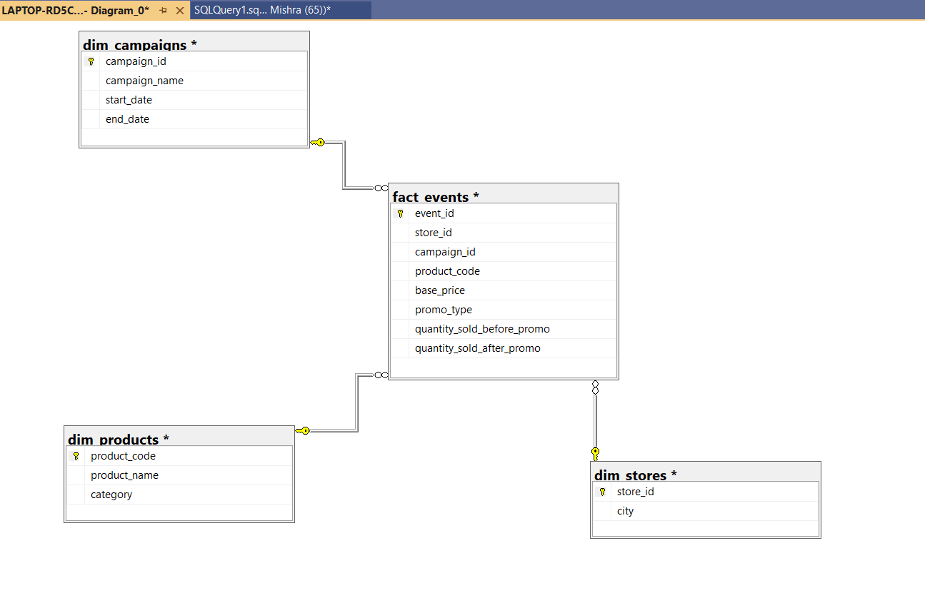
Metadata & ER Diagram

Slide 10
Data
Detailed Analysis
Descriptive KPIs · Campaign · Promotions · Categories · Cities · Products

Slide 11
Descriptive Analysis – Key KPIs at a Glance
09 | Descriptive Analysis – Key KPIs at a Glance
₹24.8 Cr
₹9.99 Cr
106.2%
Total Discounted Revenue
Total Base Revenue
Avg Sales Growth
1,500
50
10
Sales Events
Stores
Cities
Key Facts at a Glance
→ 2 campaigns ran across Nov 2023–Jan 2024
→ 5 promo types: BOGOF, 500 Cashback, 33%/50%/25% OFF
→ 15 products across 5 categories in 10 cities
→ 400 events showed negative growth (25% OFF promo)

Slide 12
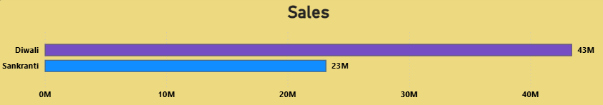
Campaign Performance – Diwali vs Sankranti
Campaign Performance – Diwali vs Sankranti
Diwali 2023
Sankranti 2024
Nov 12–18, 2023
Jan 10–16, 2024
43.12 M
23.07 M
Discounted Revenue
Discounted Revenue
Events:
750 events
Events:
750 events
Campaign ID:
CAMP_DIW_01
Campaign ID:
CAMP_SAN_01
Revenue Share:
64.6% of revenue
Revenue Share:
35.4% of revenue

Slide 13
Promotion Type Analysis – Which Promo Worked Best?
11 | Promotion Type Analysis – Which Promo Worked Best?
BOGOF
Avg Growth: 261.2%
⭐ BEST
n=500 events
Buy-one-get-one-free drove the highest average growth. Customers perceived massive value, triggering impulse purchases.
500 Cashback
Avg Growth: 162.2%
✅ GREAT
n=100 events
Direct cashback on high-ticket items drove strong uplift. Limited to 100 events — only used on Combo1 (₹3,000).
33% OFF
Avg Growth: 43.3%
👍 GOOD
n=200 events
Moderate discount generated positive but limited growth. Works well for mid-price categories.
50% OFF
Avg Growth: 33.5%
👍 GOOD
n=300 events
Despite being a large discount, growth was lower than BOGOF — possible margin erosion without volume uplift.
25% OFF
Avg Growth: -15.4%
❌ AVOID
n=400 events
Negative growth across all 400 events. Customers reduced purchases at 25% OFF — price point too close to base price to motivate action.

Slide 14
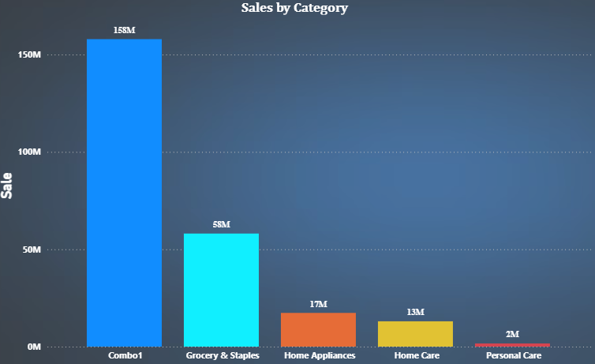
Category Sales Performance Analysis
Combo offers generated the highest revenue (158M).
Grocery & Staples shows strong consistent demand (58M).
Home Appliances and Home Care have moderate sales.
Personal Care has the lowest sales (2M) and needs better promotion.

Slide 15
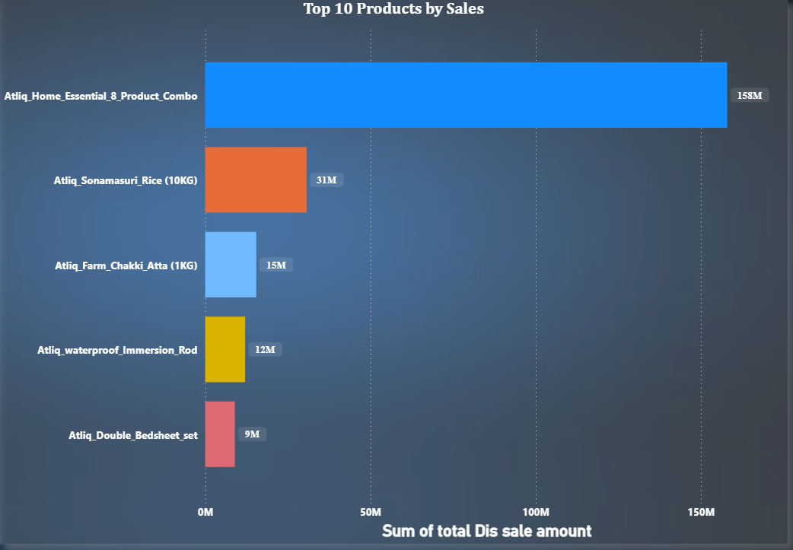
Top 5 Products
This chart shows the Top 5 products in terms of total sales.
Atliq_Home_Essential_8_Product_Combo has 158M sales, which is significantly higher than the other products.
This indicates that combo bundle products are extremely popular among customers.
The remaining products such as Rice, Atta, Immersion Rod, and Bedsheet contribute moderate sales ranging from 9M to 31M.
This suggests that essential grocery products maintain stable demand, while combo offers drive the highest revenue.
TOP 5 Product

Slide 16
City & Store Analysis – Regional Performance
Bengaluru
₹5.97 Cr
Revenue Share: 24.1%
Chennai
₹4.75 Cr
Revenue Share: 19.1%
Hyderabad
₹3.79 Cr
Revenue Share: 15.3%
Top 3 cities (Bengaluru, Chennai, Hyderabad) contribute 58.5% of total revenue.

Slide 17
Key Insights & Recommendations
🚀 BOGOF is the Most Effective Promotion
⚠️ Eliminate 25% OFF Immediately
📌 Recommendation:
📌 Recommendation:
Scale BOGOF promos across Grocery & Home Care in ALL future campaigns. It consistently delivers 261% avg growth.
This promo type caused negative sales growth across 400 events. Replace with higher-value promos (BOGOF or Cashback).
💰 500 Cashback Works Exceptionally on High-Value Items
🏆 Grocery & Staples is the Revenue King
📌 Recommendation:
📌 Recommendation:
Expand 500 Cashback beyond Combo1 to other high-ticket products like Home Appliances (Immersion Rod).
Grocery dominates at 37.6%. Invest more stock and promo budget here. Pair with BOGOF for maximum impact.
🌆 Double Down on Metro Cities
📦 Combo Products Drive Outsized Value
📌 Recommendation:
📌 Recommendation:
Top 3 cities (BLR, CHN, HYD) = 58.5% of revenue. Increase store count and campaign intensity in these cities.
The 8-product combo generated ₹3.16 Cr alone. Design more bundle packages for festive season campaigns.

Slide 18
Data
THANK YOU

